Slide 1
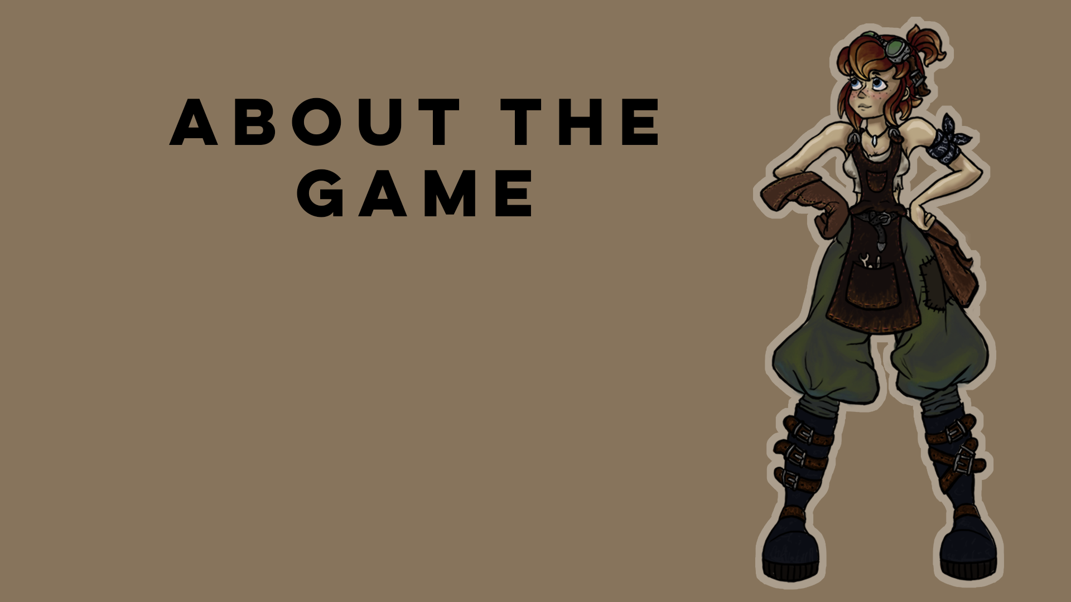
Hollow
(working title)

Slide 2
ABOUT THE GAME
GAMEPLAY AND GENRE
Our project is a narrative-driven 3D adventure puzzle platformer game. We want the player to feel like he’s/she’s playing a movie. In order to achieve this we try to blur the lines between gameplay and cinematics. The player will be able to traverse the world in both 3D and 2D perspectives. This will vary depending on the situational needs of the game’s progression. Our levels will be non-linear in design. The player will have interesting obstacles to overcome such as: interesting puzzles, thrilling chase scenes and sneaking passed aggressive enemies.
You play as our main protagonist Gearona. She’s a smart and spunky young woman who works alongside her Grandpa in his shop, located in a small town which is known for its myths and fairytales. Together they create handy little inventions for the citizens; inventions such as Trickster, Gearona’s silly sidekick. One day after scavenging for parts for a new invention, Gearona returns to the shop to find that Grandpa has been kidnapped. It appears that Grandpa has been taken to an underground world described in one of the most known fairytales; the tale of Hollow. Gearona undertakes her adventure to save Grandpa, but discovers more mysteries that lay hidden beneath the surface.

Slide 3
THE STORY
Gearona is a young woman living in the small town Terrahaven, known for its many caves. She is an orphan, living and working with her Grandpa in his Tinksmith shop. A Tinksmith is the combination of a tinker and a blacksmith and is known for making new handy invention. Inventions like Trickster, a small helper robot that Gearona invented together with Grandpa when she was 7 years old. Life is peaceful in Terrahaven until everything changes for Gearona.
When Gearona comes back to the shop after scavenging for some parts for a new invention she is shocked to find the workspace is a mess and Grandpa is missing! Trickster comes out of hiding, points towards a children’s book and claims that Grandpa has been taken to a fairytale underground world known as “Hollow.” Gearona, a woman of science rejects this claim when suddenly Grandpa’s voice emerges from the radio: “Gearona…Hollow….help!”
Gearona’s decision is made; she wants to save Grandpa, no matter what!
Gearona can’t help but wonder: Where was he brought? Who is behind all this? And above all. Why was Grandpa taken?
Travel and explore a forgotten, fantastical world along Gearona’s side. Experience a thrilling story, unravel the past and discover an unbelievable secret!
Maybe Story all plotpoints and world?

Slide 4
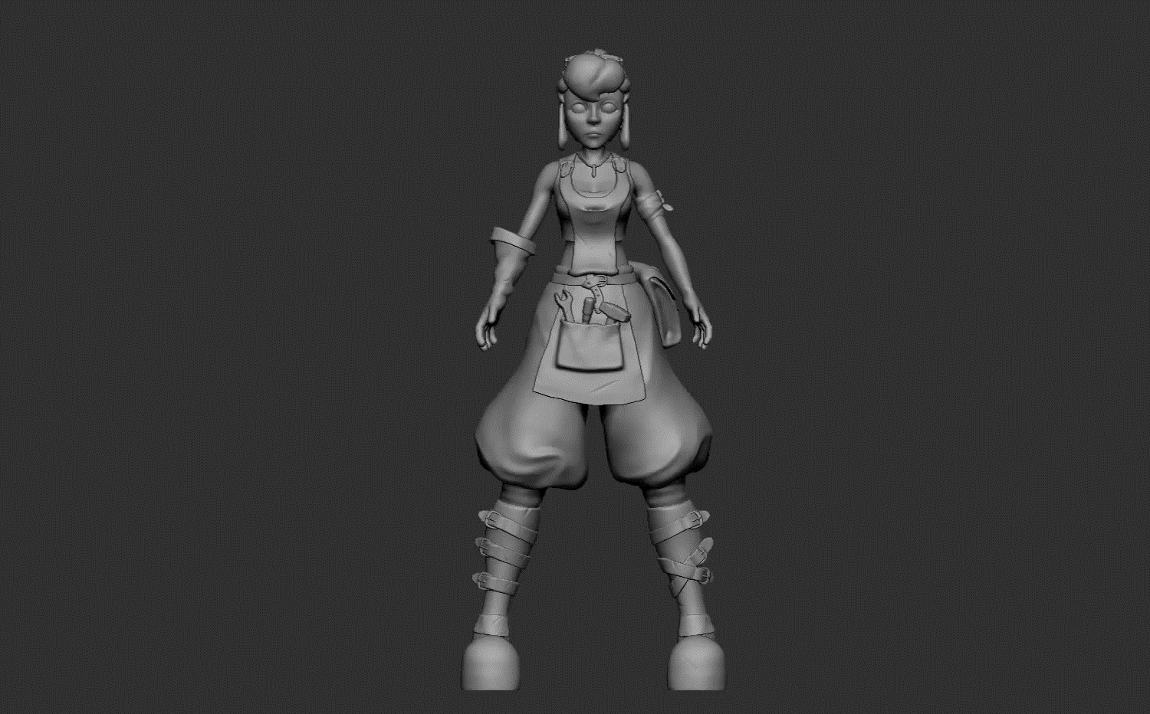
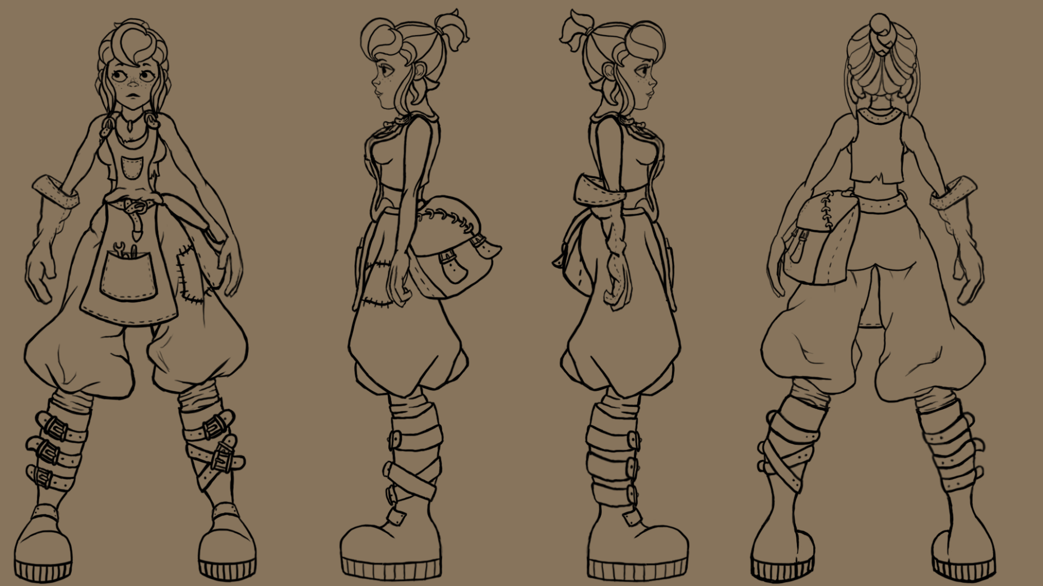
ART/ CURRENT PROGRESS

Slide 5
OUR GOAL
Proof of concept
Demo
Kickstarter
Indie game and starting company

